Slide 1
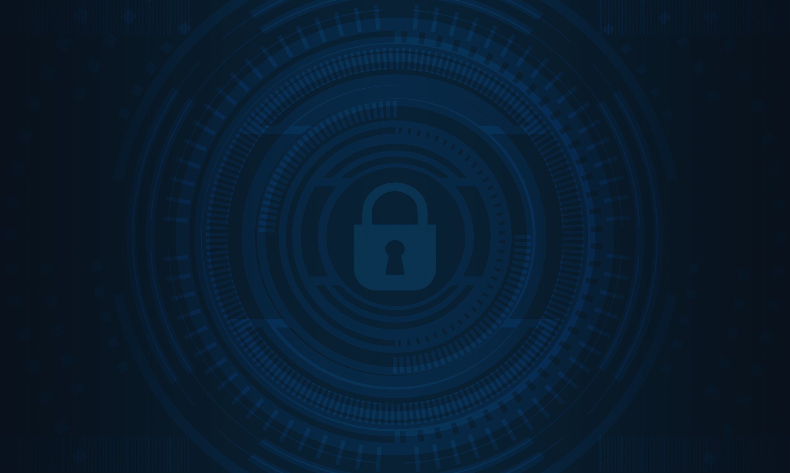
Hacking The Future
PREPARED BY
Ahmed Eldesouki : 230100444
Fady Mahros : 230103236
Marwan Hossam : 230104805
Omar Ahmed : 230104579
Mobarak Yehia : 230104617

Slide 2

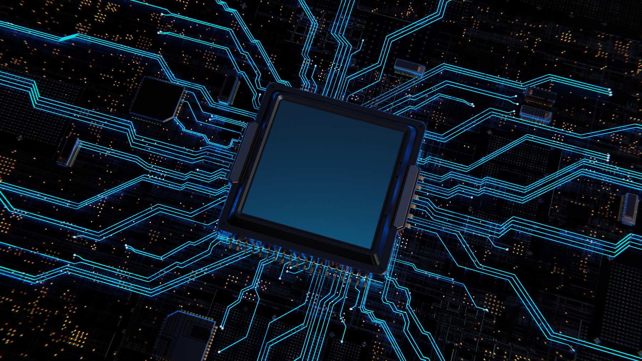
Introduction
What is Cybersecurity?
Protecting system & devices
Privacy ,accuracy , accessibility
Importance in modern world.

Slide 3
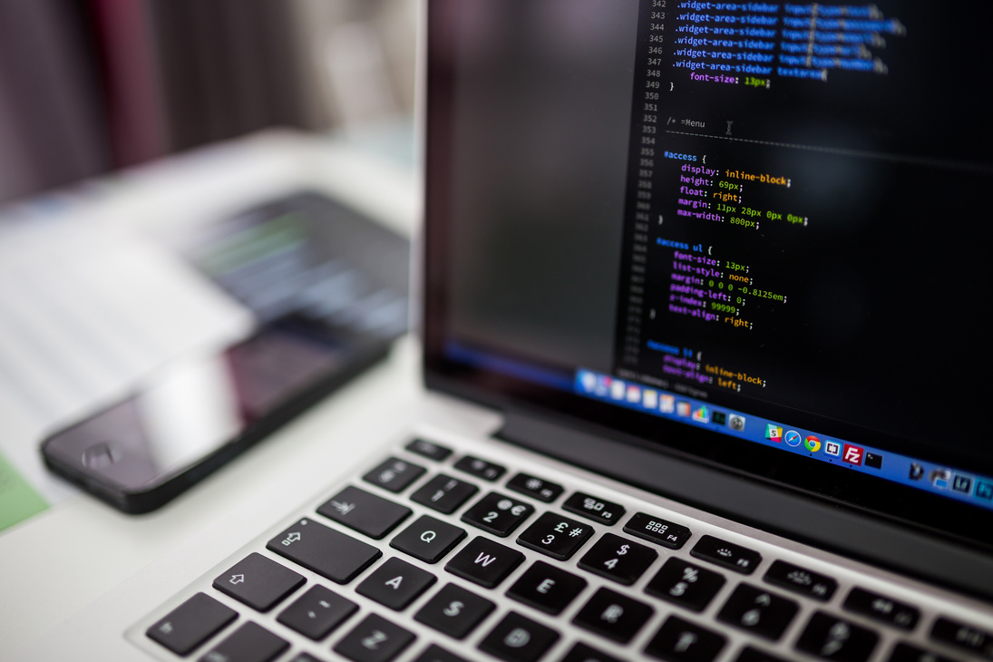
Cybersecurity Approaches
Compliance Based-approach :
Rules to counter common threats
Risk Based :
Identifying and addressing specific risk
AD Hoc :
Iterative testing to eliminate weakness

Slide 4

Importance OF
Cybersecurity
1.
Prevent identity theft
2.
Safeguards national security
3.
Protect personal & corporate data
4.
Essential in a rapidly evolving
Digital world

Slide 5
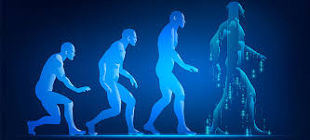
History OF
Cybersecurity
1
First cyberattack
(France, 1834): Telegraph hacking.
2
RABBITS Virus
(1969): First computer virus
3
Kevin Mitnick
(1970-1995): First "true cybercriminal.

Slide 6

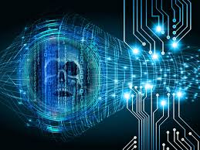
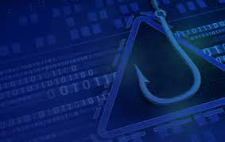
Modern Cyber Threats
1.
2.
RANSOMWARE
Malware
Harmful software/viruses
Data encryption for ransom
3.
4.
DOS Attack
Phishing
Dos attack overloading systems
Deceptive fake websites

Slide 7
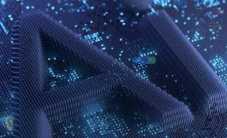
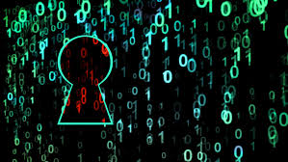
Emerging Threats
1.
2.
Exploiting vulnerabilities in national and global systems.
Artificial Intelligent

Slide 8
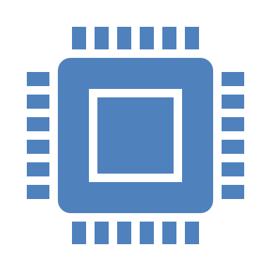


Quantum Computing Impact
Faster data processing with qubits (e.g., 00, 10, 01, 11).
Strengthening data encryption.
Risks to traditional cryptography.

Slide 9
IOT & It’s Risk
IoT Devices: Connectivity and data sharing.
Threats: Supply chain attacks, unauthorized access.
Solutions: Regular updates, strong passwords, encryption.

Slide 10
Types of IOT Risk
Supply Chain Attacks: Virus spreads through networks.
Unauthorized Access: Data theft or manipulation.
Mitigation strategies: Software updates, encryption.

Slide 11
Future of Cybersecurity
Dynamic threats demand innovative solutions.
Individuals and critical infrastructures as targets.
Shift to proactive security measures.

Slide 12
Emerging Cybersecurity Technology
AI/ML.
Rapid detection.
Predict vulnerabilities.
Automate responses.
Big Data Algorithms.

Slide 13
Quantum-Resilient Encryption
Overcoming risks from quantum computing.
Future-proofing critical communications.

Slide 14
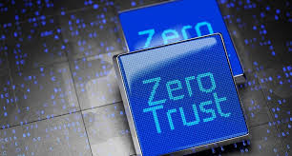
ZERO-
Trust Architecture
Continuous authentication
Reducing reliance on traditional permitter
Identity and access management integration

Slide 15
Conclusion
Cybersecurity must continuously evolve.
Collaboration and innovation are key.
Future threats demand quantum-resilient and AI-driven solutions.

Slide 16
THANK
YOU!
YOU!
Group 19

